Slide 2
BIODIVERSITY
Father of biodiversity is the sociobiologist “Edward Wilson”. He popularised the term “Biodiversity”, but the term “Biodiversity” was coined by “W.G.Rosen”.
Edward Wilson describe biodiversity as the combined diversity at all the level of biological organisation ranging from macromolecule within the cell to genes,gene pools, species,ecosystem and biomes .
It is existence of wide variety of species (species diversity) or other taxa of plants, animals and microorganisms in a natural habitat or of communities within a particular environment (ecological diversity )or of genetic variation within a species (Genetic diversity).
Biodiversity ( synonym for “life on earth”) or biological diversity (Greek word “BIOS” means life and “Diversity” means variety) is the occurrence of different type of ecosystems, different species of organisms, with their biotype and genes adapted to different climates, environment along with their interactions and processes.
It is the sum total of diversity that exist at all level of biological organisation.

Slide 4
BIODIVERSITY
It refer to the totality of genes, species and ecosystem of a region. it is sum total of species richness.
It is wide variety of life on earth.
It is the degree of variety in nature and not nature itself. it is variability among living organisms from all sources. it is the variety of life forms, the ecological roles they play and the Genetic diversity they contains.

Slide 5
The term ‘Biodiversity’ was introduced by an American Biologist Edward Wilson.
Biodiversity refers to the variety of life forms and habitats found in a defined area.
It represents the totality of genes, species and ecosystem of a given region.

Slide 6
The biological diversity includes three inter-related hierarchical levels :
Biological Diversity
Genetic Diversity
Species Diversity
Ecological Diversity

Slide 7
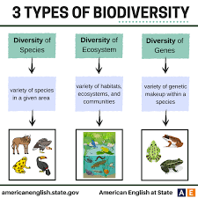

Slide 8
GENETIC DIVERSITY
The genetic variation existing within a species is called genetic diversity.
The variation may be in alleles, total genes or
chromosome structures.
Number of genes in the followings:
Mycoplasma Escherichia coli
Drosophila melanogaster Oryza sativa
Homo sapiens
:450-700
:4000
:13000
:32000-50000
:35000-45000

Slide 9
SPECIES DIVERSITY
The diversity at the species level is called species diversity.
Example:- The Western Ghats have a greater amphibian species diversity than Eastern Ghats.
The species diversity depends upon the number and richness of the species of a region.
Species richness - The number of species per unit area.

Slide 10
ECOLOGICAL DIVERSITY
The diversity at the ecosystem level is called ecological diversity.
Example: Deserts, rain forests, mangroves, coral reefs, wetlands, estuary and alpine meadows etc.

Slide 11
Rain Forest
Mangrove
Estuary
Coral reef

Slide 13
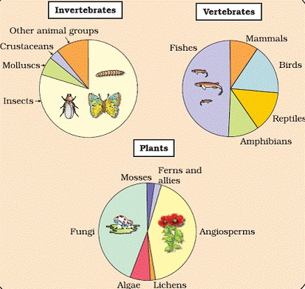

Slide 14
According to the IUCN (2004) report, the total number of plant and animal species is more than 1.5 million.
Robert May estimated that the global species diversity is at about 7 million.
More than 70 per cent of all the species recorded are animals and plants including algae, fungi, bryophytes, gymnosperms and angiosperms comprise about 22 per cent of the total.

Slide 15
Among animals, insects are making up more than 70 per cent of the total. Out of every 10 animals on this planet, 7 are insects.
The number of fungi species in the world is more than the combined total of the species of fishes, amphibians, reptiles and mammals.
India has only 2.4 per cent of the world’s land area, but
shares 8.1 per cent of the global species diversity .
India is one of the 12 mega diversity countries of the world.

Slide 16
Representing global biodiversity: proportionate number of species of major taxa of plants, invertebrates and vertebrates

Slide 17
Biodiversity is not uniform throughout the world but shows uneven distribution.
Biodiversity is affected by two factors:
Latitudinal Gradient
Species- area relationship

Slide 18
In general, species diversity decreases as we move away from the equator towards the poles.
Few exceptions: tropics (latitudinal range of 23.5° N to 23.5° S) harbour more species than temperate or polar areas.
Colombia located near the equator has nearly 1,400 species of birds while New York at 41° N has 105 species and Greenland at 71° N only 56 species.
India, with much of its land area in the tropical latitudes, has more than 1,200 species of birds.

Slide 19
Amazon Rain Forest

Slide 20
Amazon Rain Forest
 The largely tropical Amazonian rain forest in South America has the greatest biodiversity on earth- it is home to more than 40,000 species of plants, 3,000 of fishes, 1,300 of birds, 427 of mammals, 427 of amphibians, 378 of reptiles and of more than 1,25,000 invertebrates.

Slide 21
GREATER BIOLOGICAL DIVERSITY IN TROPICS
Various hypotheses for higher diversity in tropics proposed by ecologists and evolutionary biologists are :
Temperate regions have undergone frequent glaciations in the past. It killed most the species. Tropical latitudes have remained relatively undisturbed for millions of years.
Tropical environments are less seasonal which promote niche specialization and lead to a greater species diversity.
More solar energy is available in the tropics which contributes to higher productivity and in turn might contribute indirectly to greater diversity.

Slide 22
SPECIES-AREA RELATIONSHIPS
Alexander von Humboldt
was a German naturalist and explorer.
He observed that within a region species richness increased with increasing explored area, but only up to a limit.
The relation between species richness and area for a wide variety of taxa is to be a rectangular hyperbola.

Slide 23
SPECIES-AREA RELATIONSHIPS
On a logarithmic scale, the relationship is a straight line described by the equation:
log S = log C + Z log A where
S= Species richness
A= Area
Z = slope of the line (regression coefficient) C = Y-intercept

Slide 24
IMPORTANCE OF SPECIES DIVERSITY
TO THE ECOSYSTEM
Stability
Productivity
Ecosystem Health

Slide 25
Due to human activities biological resources have been declining rapidly.
The colonisation of tropical Pacific Islands by humans led to the extinction of more than 2,000 species of native birds.
More than 15,500 species are facing the threat of extinction in the worldwide.
At present,12 per cent of birds, 23 per cent of mammals, 32 per cent of amphibians and 31per cent of gymnosperms face the threat of extinction.

Slide 26
QUAGGA
(Africa)
Steller’s Sea Cow (Russia)
DODO
(Mauritius)
THYLACINE (Australia)

Slide 27
MASS EXTINCTION
Due to natural calamities a large number of species become extinct which is called mass extinction.
Since the origin and diversification of life on earth
there were five episodes of mass extinction of species.
The "Big Five" mass extinctions are as follows:
End Ordovician (Ordovician-Silurian extinction)
Late Devonian (Late Devonian extinction)
End Permian (Permian-Triassic extinction)
End Triassic (Triassic-Jurassic extinction)
End Cretaceous (Cretaceous-Tertiary extinction)

Slide 28
The ‘Sixth Extinction’ is presently in progress which is different from the previous episodes.
The current species extinction rates are to be 100 to 1,000 times faster than in the pre-human times and human activities are responsible for the faster rates.
Ecologists warn that if the present trends continue, nearly half of all the species on earth might be wiped out within the next 100 years.

Slide 29
1
Decline in plant production
Lowered resistance to environmental perturbations such as drought
2
Increased variability in certain ecosystem processes such as plant productivity, water use, and pest and disease cycles
3

Slide 30
Causes of Biodiversity Loss
Habitat loss and fragmentation
Over- exploitation
Alien species invasions
Co-extinctions

Slide 31
Destruction of habitat is the primary cause of extinction of species.
The tropical rainforests initially covered 14% of land
but now only 6%.
The Amazon rain forest is called ‘‘The lungs of the planet’’.
When large sized habitats are broken into small fragmented due to human activities certain animals are badly affected and threatens their survival.

Slide 32
When natural resources are over exploited by human due to his greed,it results the degradation and extinction of the resources.
e.g. Steller’s sea cow, passenger pigeon.

Slide 33
Nile Perch
African Cichild Fish
The introduction of Nile perch into lake Victoria led extinction of more than 200 species of indigenous cichild fish.

Slide 34
Alien species invasion
The recent illegal introduction of the African catfish Clarias gariepinus is posing threat to indigenous catfishes in India.

Slide 35
Lantana
Carrot Grass :
Parthenium
Water hyacinth: Eicchornia

Slide 36
When a species become extinct, the plant and animal species associated with it in an obligatory manner, also become extinct.
For example, if the host fish species becomes extinct, all those parasites exclusively found on it will also become extinct.

Slide 37
Narrowly utilitarian
Broadly utilitarian
Ethical argument

Slide 38
Food
(cereals, pulses, fruits)
Industrial
products
Firewood
Economic benefits from nature
Fibre
Construction
material
Medicines

Slide 39
Ecosystem services
Aesthetic pleasures of walking through thick woods, watching
spring flowers etc.
Amazon forest produce 20% of the total oxygen in the atmosphere on earth.
Pollination of plants through pollinators: bee, birds and bats.

Slide 40
There are millions of plants, animals and microbes on this earth with whom we share.
Each species on this earth has some intrinsic value.
It is therefore our moral duty to take care of all the living creatures and pass on our biological legacy in good order to future generations.

Slide 41
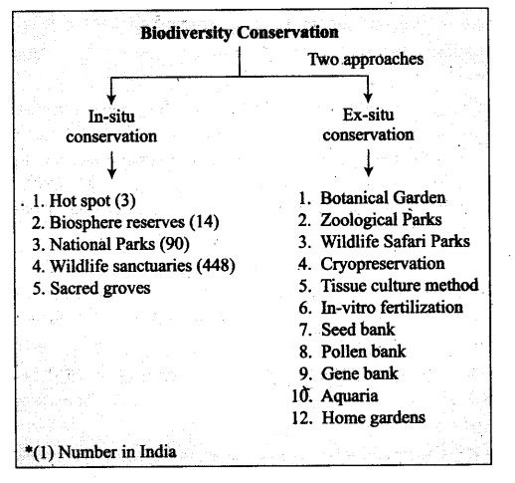

Slide 42
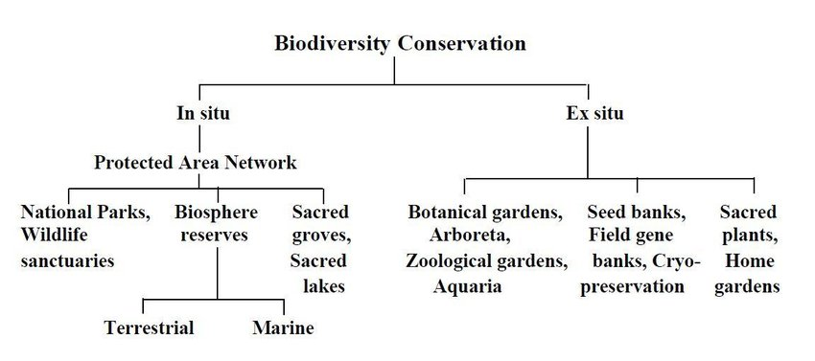

Slide 43
National Parks and Wildlife Sanctuaries are the suitable place for biodiversity conservation. National Parks and Wildlife Sanctuaries are protected areas declared by Government with the primary objective to preserve wildlife, save flora & fauna and restore the natural ecological balance.
There are 103 National Parks and 544 Wildlife Sanctuaries in India. Madhya Pradesh and Andaman & Nicobar Islands have the maximum number of National Parks (9 each). The spectacular natural beauty across the national parks and wildlife sanctuaries in India attracts millions of tourists every year.
Largest National Park: Hemis National Park, Jammu & Kashmir
Smallest National Park: South Button Island National Park, Andaman and Nicobar Islands
Largest Wildlife Sanctuary: Rann of Kutch, Gujarat
Smallest Wildlife Sanctuary: Bor Tiger reserve, Maharashtra

Slide 44
How many National Parks are there in India?
Ans. There are a total of 103 National Parks in India (as of 2020).
Q 2. How many National Parks are there in India?
Ans. There are a total of 544 Wildlife Sanctuary in India (as of 2020).
Q 3. Which is the largest national park in India?
Ans. Hemis National Park is the largest National Park in India, located in Jammu and Kashmir. It stretches over nearly 4,400 km².
Q 4. Which is the largest Wildlife Sanctuary in India?
Ans. The largest Wildlife Sanctuary in India is Rann of Kutch.
Q 5. Which state has maximum number of national parks?
Ans. Madhya Pradesh and Andaman and Nicobar Islands have the maximum number of National Parks (9 each).
Q 6. Which state has maximum number of Wildlife Sanctuaries in India?
Ans. Andaman & Nicobar Islands has the maximum number of wildlife sanctuaries i.e. 96, while Maharashtra has 42 Wildlife Sanctuaries.
Q 7. Where is Bandipur National Park in India?
Ans. Bandipur National Park is located in Karnataka.

Slide 45
BIOSPHERE RESERVE
Biosphere Reserve (BR) is an international designation by United Nations Educational, Scientific and Cultural Organization (UNESCO) for representative parts of natural and cultural landscapes extending over large areas of terrestrial or coastal/marine ecosystems or a combination of both.
Biosphere Reserves tries to balance economic and social development and maintenance of associated cultural values along with the preservation of nature.
Biosphere Reserves are thus special environments for both people and nature and are living examples of how human beings and nature can co-exist while respecting each others’ needs.
STRUCTURE OF BIOSPHERE RESERVE
A.Core Zone:
It is the most protected area of a biosphere reserve.
It may contain endemic plants and animals.
They conserve the wild relatives of economic species and also represent important genetic reservoirs having exceptional scientific interest.
A core zone is a protected region, like a National Park or Sanctuary/protected/regulated mostly under the Wildlife (Protection) Act, 1972.
It is kept free from human interference.

Slide 46
STRUCTURE OF BIOSPHERE RESERVE
B.Buffer Zone:
The buffer zone surrounds the core zone and its activities are managed in this area in the ways that help in the protection of the core zone in its natural condition.
It includes restoration, limited tourism, fishing, grazing, etc; which are permitted to reduce its effect on the core zone.
Research and educational activities are to be encouraged.
C. Transition Zone:
It is the outermost part of the biosphere reserve. It is the zone of cooperation where human ventures and conservation are done in harmony.
It includes settlements, croplands, managed forests and areas for intensive recreation and other economic uses characteristics of the region.

Slide 47
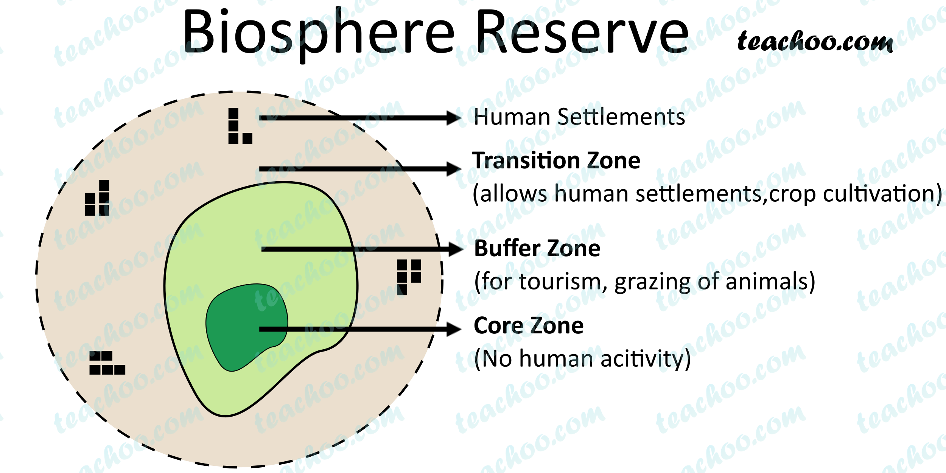

Slide 48
Biosphere Reserves in India
There are 18 biosphere reserves in India:
1.Cold Desert, Himachal Pradesh
2.Nanda Devi, Uttrakhand
3.Khangchendzonga, Sikkim
4.Dehang-Debang, Arunachal Pradesh
5.Manas, Assam
6.Dibru-Saikhowa, Assam
7.Nokrek, Meghalaya
8.Panna, Madhya Pradesh
9.Pachmarhi, Madhya Pradesh
10.Achanakmar-Amarkantak, Madhya Pradesh-Chhattisgarh
11.Kachchh, Gujarat (Largest Area)
12.Similipal, Odisha
13.Sundarban, West Bengal
14.Seshachalam, Andhra Pradesh
15.Agasthyamala, Karnataka-Tamil Nadu-Kerala
16.Nilgiri, Tamil Nadu-Kerala (First to be Included)
17.Gulf of Mannar, Tamil Nadu
18.Great Nicobar, Andaman & Nicobar Island

Slide 49
In situ conservation
Ex situ conservation
Conservation and protection of whole ecosystem, protection of its biodiversity at all levels.
Eg. Biosphere reserves, National parks, wildlife sanctuaries, Sacred groves
Protection of animals or plants when they are in endangered or threatened and needs urgent measures to save from extinction.
Eg. Zoological parks, botanical gardens and wildlife safari

Slide 50
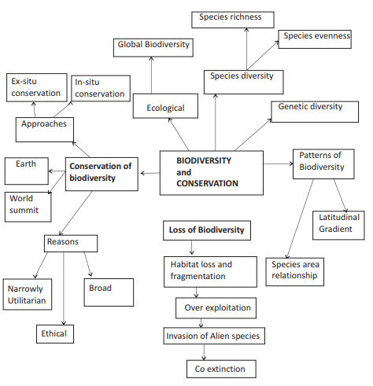

Slide 52
The Earth Summit held in Rio de Janeiro in 1992.
The World Summit on Sustainable Development
held in Johannesburg, South Africa in 2002 .
In this Summit, 190 countries pledged their commitment to reduce the current rate of biodiversity loss at global, regional and local levels by 2010.

Slide 53
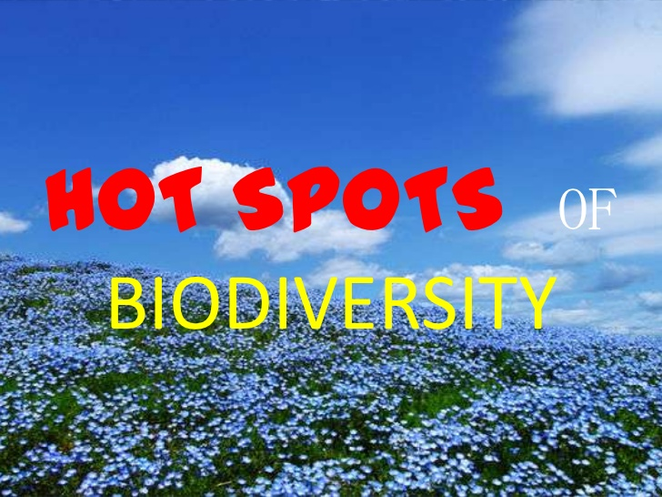

Slide 54
BIODIVERSITY HOTSPOTS
Biodiversity hotspots are Earth’s most biologically rich—yet threatened—terrestrial regions.
To qualify as a biodiversity hotspot, an area must meet two strict criteria:
1.Contain at least 1,500 species of vascular plants found nowhere else on Earth (known as "endemic" species).
2.Have lost at least 70 percent of its primary native vegetation.
Many of the biodiversity hotspots exceed the two criteria. For example, both the Sundaland Hotspot in Southeast Asia and the Tropical Andes Hotspot in South America have about 15,000 endemic plant species. The loss of vegetation in some hotspots has reached a startling 95 percent.
Maximum protection certain ‘biodiversity hotspots’ regions with very high levels of species richness and high degree of endemism (that is, species confined to that region and not found anywhere else).
Initially 25 biodiversity hotspots were identified but subsequently nine more have been added to the list, bringing the total number of biodiversity hotspots in the world to 34. These hotspots are also regions of accelerated habitat loss.

Slide 55
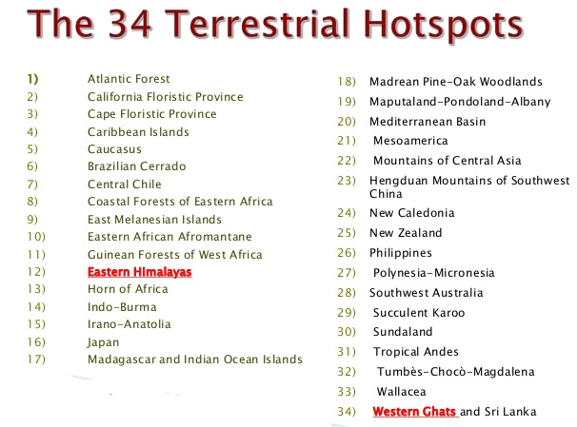

Slide 56
HOT SPOTS IN INDIA
Three of these hotspots –
Western Ghats and Sri Lanka,
Indo-Burma and Himalaya – cover our country’s exceptionally high biodiversity regions.
Sundaland
Although all the biodiversity hotspots put together cover less than 2 percent of the earth’s land area, the number of species they collectively harbour is extremely high and strict protection of these hotspots could reduce the ongoing mass extinctions by almost 30 per cent.

Slide 57
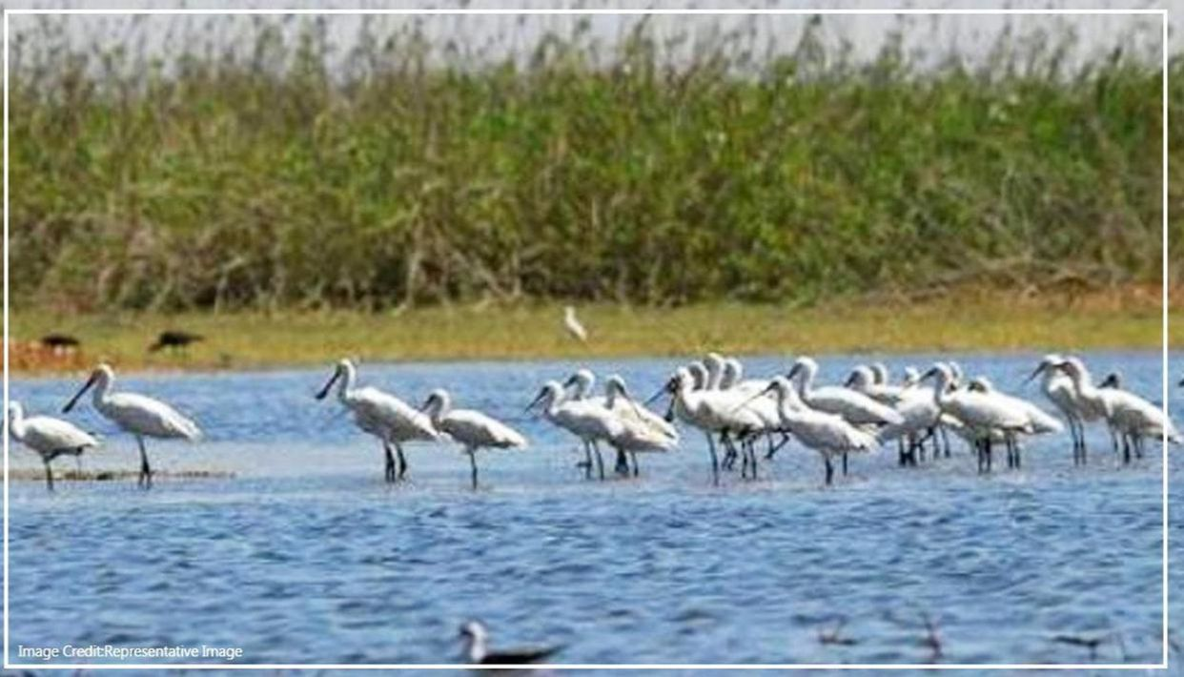
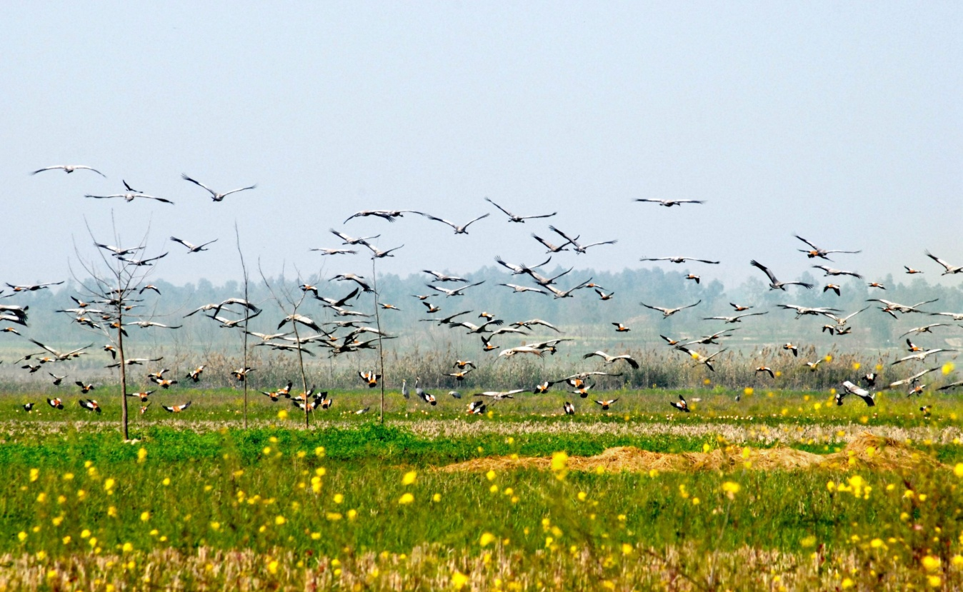
RANSAR SITES

Slide 58
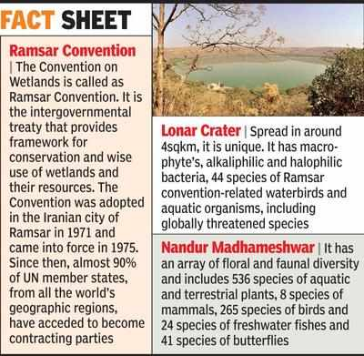

Slide 59
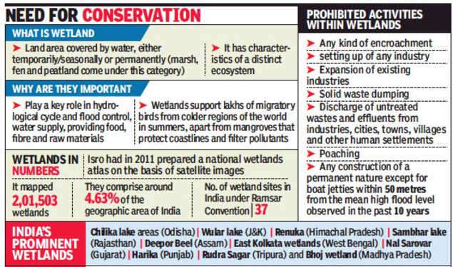

Slide 60
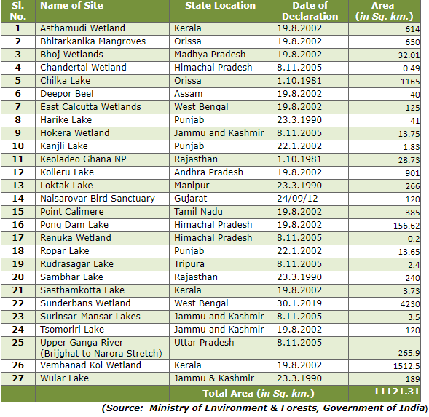

Slide 61
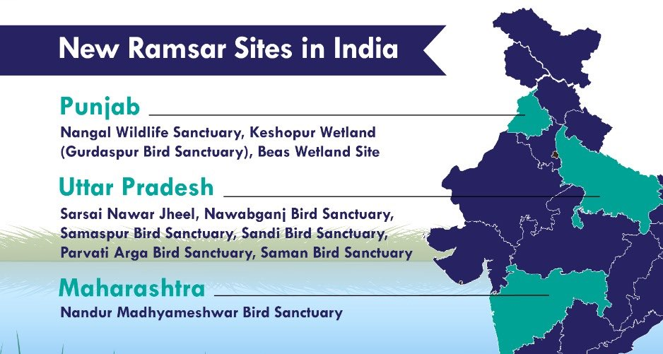
10 NEW RAMSAR SITES(27+10=37)

